Slide 1
Letters of Intent and Term Sheets
Foster Swift Collins & Smith, P.C.
Nick Oertel, Shareholder
noertel@fosterswift.com
517-371-8139

Slide 2
What is a Letter of Intent? What is a Term Sheet
They are both very similar
A letter of intent is a written statement detailing the preliminary understanding of parties who plan to enter into a contract. It is typically signed and contains non-binding and binding provisions.
Same definition for term sheet – although term sheet typically not signed
The form may vary slightly but each are used to outline key proposed terms of the contemplated transaction before committing resources necessary to negotiate finer points and draft a definitive agreement.
Are the parties generally on the same page to justify moving forward?

Slide 3
Location in the M&A Process
Step 1: Confidentiality Agreement and initial discussions
Step 2: Letter of Intent
Step 3: Due diligence
Step 4: Definitive Agreement
Step 5: Closing
The LOI and Term Sheet are a tool to ensure that the parties are in broad enough agreement to justify moving forward to negotiate the finer points or otherwise undecided topics.
Typically, at the LOI stage, the parties only have limited information about each other and have not conducted in-depth due diligence. Therefore, many of the proposed terms are non-binding.

Slide 4
Term Sheets and Letters of Intent
My experience is that letter of intent are more frequently used in the M&A context. Although term sheets are not uncommon.
Both have their advantages and disadvantages – although either is generally sufficient to accomplish the general purpose of determining whether the parties are generally on the same page to justify moving forward and to provide a roadmap for the path forward.

Slide 5
Advantages of Letters of Intent and Term Sheets
Help avoid misinterpretations by putting key points in writing.
Discourages re-negotiation of key points. Moral obligation not to deviate.
Aids in negotiation of definitive agreements by identifying areas that require further discussion
Aids in drafting the definitive agreement by giving draftsperson the terms
More likely to lead to the closing of a deal?

Slide 6
Disadvantages of Letters of Intent and Term Sheets
Risk of potentially creating a binding agreement.
Michigan and Delaware cases have held such agreements can be binding in certain cases. A real trap for the hastily drafted letter of intent.
Generally favor the buyer. Buyer’s have experience with the process whereas it is likely to be Seller’s first business sale.
Creates inflexibility
Gumming up the negotiation process too early.
Your thoughts?

Slide 7
Buyer’s Perspective
Principal goal is to commit seller not to negotiate with others for a period of time (no shop/exclusivity provisions).
Don’t want to be the stalking horse.
Don’t want to waste resources/time and have deal yanked out from under them
Want LOI to include provisions which facilitate buyer’s due diligence investigation of seller and ensure seller’s cooperation in that process.
Generally are fine with the LOI being vaguer since buyer hasn’t conducted in depth due diligence.

Slide 8
Seller’s Perspective
Seller’s leverage is greatest prior to signing LOI.
Generally want to be specific as possible with respect to material terms of transaction
Crucial to address confidentiality, breaches of which can cause damage to seller, including employee, customer, and vendor relationships.
There may be an initial free standing confidentiality agreement, but the Letter of Intent should reference that confidentiality provision or impose the initial confidentiality obligation if there is not a prior free standing agreement.

Slide 9
Structure and Terms of Letter of Intent
Structured to have Non-Binding Terms and Binding Terms
Caveat: The draftsperson must be careful to ensure that the Letter of Intent does not create a binding agreement or an agreement to agree.
Legal doctrine of specific performance can require a party to complete the transaction if the letter of intent is ruled binding, even if the party did not intend so.
Language similar to below:
This letter of intent is not intended to be binding on the parties or a legally enforceable agreement, and imposes no obligations upon nor grants any rights to any of the parties. The rights and obligations of the parties shall be set forth in a definitive agreement that may be executed by the parties.

Slide 10
Structure and Terms of Letter of Intent
Guarding Against Creating a Document that is Unintentionally Binding
Include a provision that the obligations of all parties are contingent upon execution of a definitive agreement by a certain date.
Watch the language used. Use words that reflect a non-binding intent – “may” and “would” instead of “are” “shall” and “will.”
Provide that either party may terminate if a definitive agreement has not been reached by a specific date.
Intent usually controls – state within the LOI that the intent is that it is non-binding.
Identify any major points that remain to be negotiated.

Slide 11
Structure and Terms of Letter of Intent
Who should sign the Letter of Intent?
Obviously the buyer and seller
Also consider it’s execution by significant shareholders, especially if the buyer is a shell company.

Slide 12
Structure and Terms of Letter of Intent
Binding Terms. LOIs are typically binding with respect to certain terms. Careful drafting is required to indicate which provisions are binding and which are non-binding.
Confidentiality – The buyer agrees that any information obtained with respect to the seller will be treated as confidential and used only for the purpose of evaluating a transaction. Information returned or destroyed if the deal is not closed. Unilateral or mutual.
Mutual is more common – covers info that buyer may disclose and covers that the existence of a potential transaction is confidential.
Protection of trade secrets can be lost if disclosed without a written agreement.
When to enter into a confidentiality agreement?
As soon as possible and before disclosure of confidential information.
TIP: If disclosures made prior to execution of the confidential information, have confidentiality agreement cover those prior disclosures

Slide 13
Structure and Terms of Letter of Intent
Binding Terms
Confidentiality.
Who has access to disclosed information? Usually, the recipients and their advisors. Typically, the advisors and representatives do not themselves have to sign confidentiality documents, but the direct recipient will be responsible for their actions.
Issues with Direct Competitors
What info should be disclosed and how?
Sensitive information could be masked
Waiting until definitive agreement executed
Remedies
Injunctive relief in addition to monetary damages
Losing party to a dispute to pay the fees and expenses (including legal fees)

Slide 14
Structure and Terms of Letter of Intent
Binding Terms.
Exclusivity/No-Shop.
Generally demanded by buyer (don’t want to spend resources on deals which may not close or have another bid submitted that could cause buyer to have to increase its offered price).
Seller agrees that during a period of time (60-90 days is pretty typical) it will not be involved in soliciting or negotiating any competing offers.

Slide 15
Structure and Terms of Letter of Intent
Binding Terms.
Exclusivity/No Shop Continued. What is the remedy if these provisions are violated?
Possibility: Seller required to reimburse buyer’s reasonable out of pocket costs and expenses incurred in course of pursuing transaction. Seller would want to state that this is the sole remedy for the breach.
Possibility: Seller and Buyer could agree to a specific liquidated damages amount (break-up fee).
Possibility: Seller and Buyer could agree to a topping fee. – computed by reference to amount by which successful third party offer exceeds offer made by buyer.
Access. Seller will agree to provide buyer with access to books, records, personnel during diligence.
Seller may want to withhold disclosure of very highly confidential info until after a definitive agreement is executed.

Slide 16
Structure and Terms of Letter of Intent
Binding Terms.
Termination. When does the Letter of Intent end?
Common Termination Triggers:
When the parties mutually agree
When a definitive agreement is executed
If a definitive agreement is not executed by a certain date (60-90 days)
Also typically give buyer the right to terminate at any time.
Pit Fall: Lack of “at-will” termination language can have unintended consequences. If buyer quickly learns that it doesn’t want to do the deal, but cannot terminate the LOI, does it have a duty to continue negotiations (negotiate in good faith)?
Ordinary Course. Until the LOI is terminated or definitive agreement executed, Seller will agree to operate in the ordinary course of business.

Slide 17
Structure and Terms of Letter of Intent
Non-Binding Terms
Deal Structure.
Asset Deal. Buyer picks the assets that it will purchase and the liabilities that it will assume.
Buyers generally prefer because they can cherry pick the desired assets and guard against liabilities . Buyer’s also get a stepped up basis in the assets, allowing for depreciation deductions (future tax savings).
Buyer’s also get to amortize goodwill over a period of 15 years. Goodwill is the amount by which the purchase price exceeds the value of the tangible assets. If there is goodwill in a stock deal, it cannot be amortized.
Buyer’s can spend less time on due diligence because the exposure to liabilities is limited.
Stock Deal. Buyer purchases the capital stock/entire entity. Since Buyer is purchasing the entity, the Buyer gets all assets and liabilities (known and unknown).
QSBS (1202). Allows capital gains from select small businesses to be excluded from federal income tax. Maximum excludable gain of $10M or 10X the adjusted basis of the stock

Slide 18
Structure and Terms of Letter of Intent
QSBS must be issued in exchange for cash, services or property
The original holder of QSBS must be the ultimate seller of the QSBS
Five year holding period requirement
Only a C corporation with aggregate gross assets not exceed $50 million can issue QSBS.
Corporation must be engaged in qualified trade or business – any business other than certain excluded businesses (services in health, law, engineering, accounting, financial, etc.).

Slide 19
Structure and Terms of Letter of Intent
Non-Binding Terms
Purchase Price
Cash
Seller financed (i.e., Promissory Note)
Interest rate
Payment terms
Security
Indemnity Escrows
Tax Escrows (MI tax clearance)
Earn Outs
Equity rollover
Purchase Price Adjustments (net working capital)

Slide 20
Structure and Terms of Letter of Intent
Non-Binding Terms
Working Capital.
Difference between current assets and current liabilities.
Buyer’s purchase business on cash free/debt free basis
Possible in smaller deals to have no liabilities at closing, but adjustment mechanism typical for anything above a small deal.
Buyer doesn’t want to have to immediate infuse capital into the business post-closing.
A target working capital is negotiated based on historical data. Post-closing an analysis is performed to determine whether the promised working capital was delivered. Adjustments made as appropriate.

Slide 21
Structure and Terms of Letter of Intent
Non-Binding Terms
Conditions to transaction
Execution of definitive agreement
Third party consents
Completion of due diligence
Environmental issues
Financing
Employment arrangements

Slide 22
Structure and Terms of Letter of Intent
Non-Binding Terms
Representations and Warranties/Indemnity Liabilities/Escrows
Sandbagging – Most deals are silent. Few include an ant-sandbagging provision. Typically, silent means that sandbagging is permitted by default laws (Delaware)
Survival
Fundamental: broker’s fee; capitalization; due authority; due organization; title to assets; taxes
Baskets (1%)
Deductible. Seller not liable to indemnity for losses until amount of losses exceeds $100k
First Dollar. Seller not liable to indemnify for losses until amount of losses exceed $200k, in which case seller responsible for all losses, regardless of threshold
Combination
Caps

Slide 23
Structure and Terms of Letter of Intent
Non-Binding Terms
Employees
Non-compete/Non-solicitation

Slide 24
Structure and Terms of Letters of Intent
Interstate Issues
Buyer and Seller in different states
Choice of law.
Choice of venue.
Practicalities
Get local legal counsel
Specific licensing issues
Differences in laws: are non-competes enforceable, and, if so, under what terms

Slide 25
Structure and Terms of Letters of Intent
Interstate Issues
Governing law and venue are distinct. Courts in one jurisdiction can apply the law of another jurisdiction.
What is the main consideration in choosing venue?
What is the main consideration in choosing law? DE v NY

Slide 26
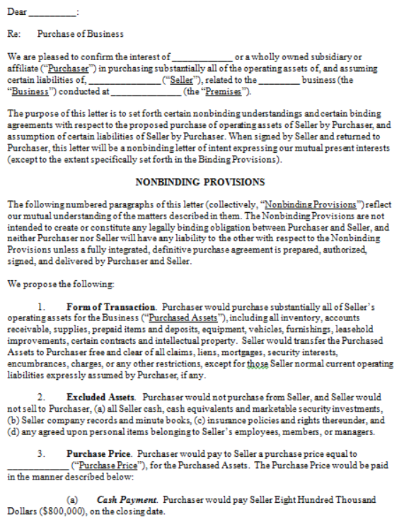

Slide 27
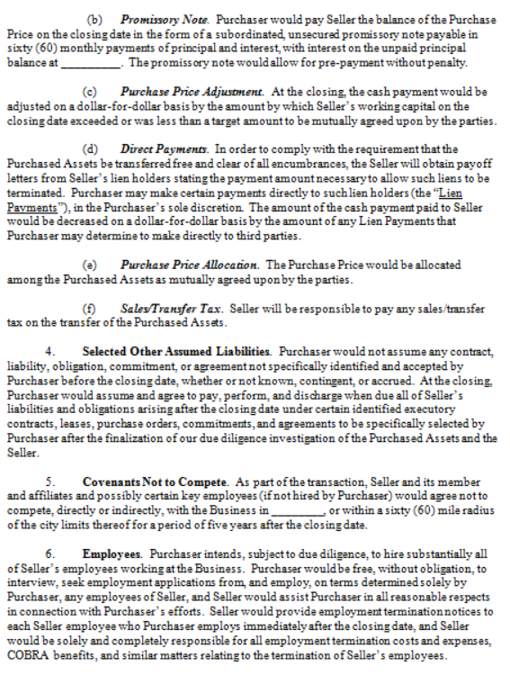

Slide 28
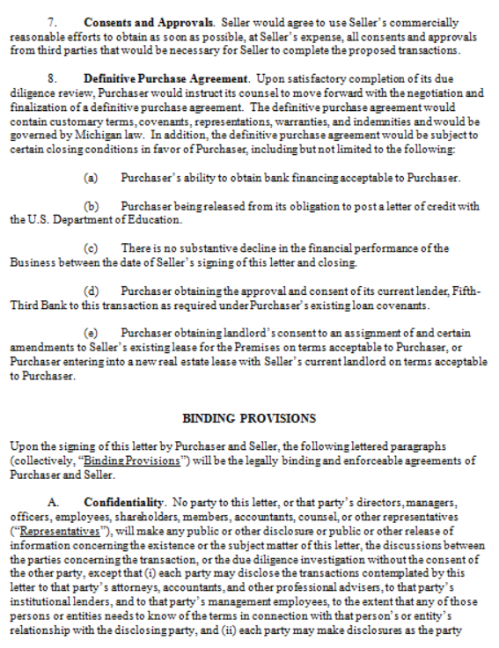

Slide 29
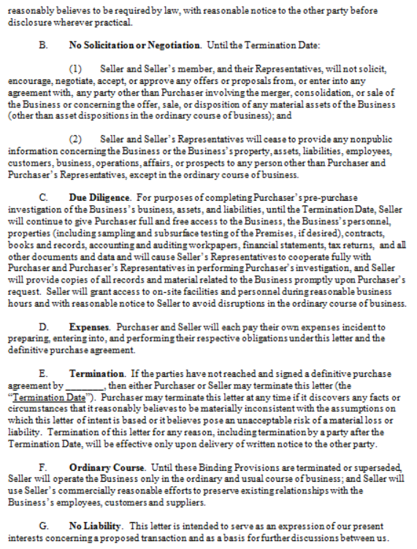

Slide 30
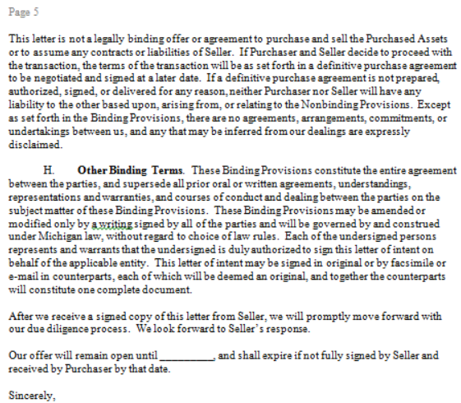

Slide 31
QUESTIONS?

